Slide 1

pocantico Hills School District
Think-create-collaborate computer science and innovation, K-8
Board of Education Presentation
January 23, 2018
ADAM BROWN
DIRECTOR OF CURRICULUM & TECHNOLOGY
BRENT HARRINGTON
PRINCIPAL

Slide 2
2016 Iste standards for students
(International society for technology in education)
1 - Empowered Learner
  Students take an active role in choosing, achieving and demonstrating competency in their learning goals.
2 - Digital Citizen
  Students recognize the rights, responsibilities and opportunities of living, learning and working in an interconnected digital world.
3 - Knowledge Constructor
  Students critically curate a variety of resources to construct knowledge, produce creative artifacts and make meaningful learning experiences for themselves and others.
4 - Innovative Designer
  Students use a variety of technologies within a design process to identify and solve problems by creating new, useful or imaginative solutions.
5 - Computational Thinker
  Students develop and employ strategies for understanding and solving problems in ways that leverage the power of technological methods to develop and test solutions.
6 - Creative Communicator
  Students communicate clearly and express themselves creatively for a variety of purposes using the platforms, tools, styles, formats and digital media appropriate to their goals.
7 - Global Collaborator
  Students use digital tools to broaden their perspectives and enrich their learning by collaborating with others and working effectively in teams locally and globally.

Slide 3
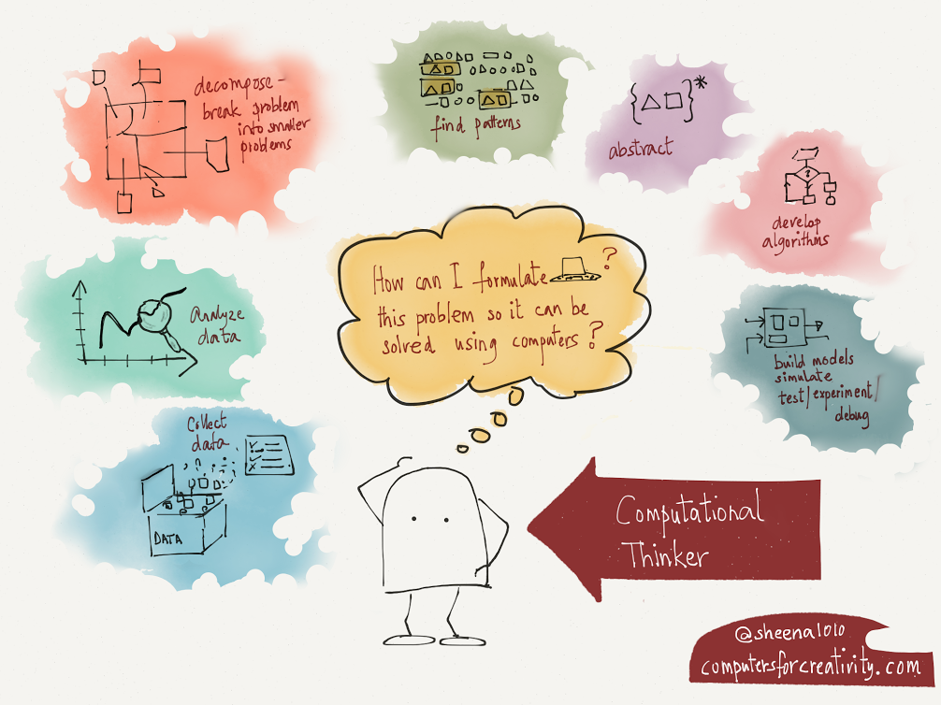

Slide 4
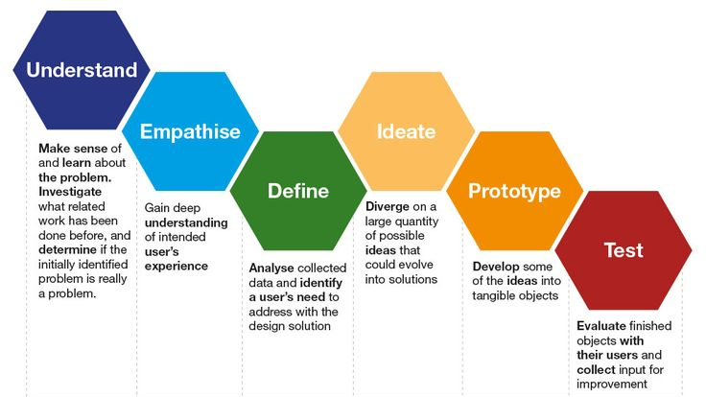
ENGINEERING DESIGN PROCESS

Slide 5
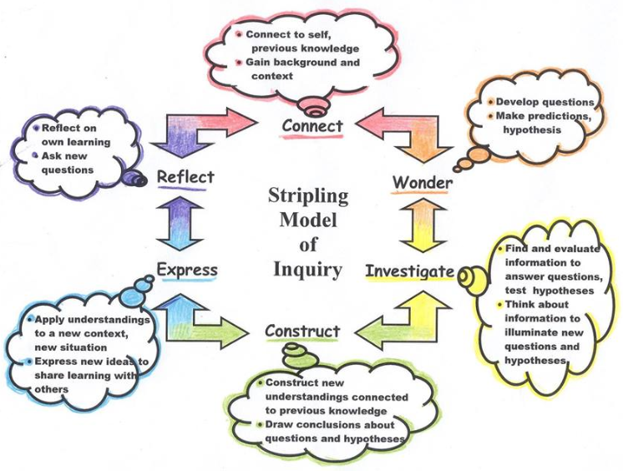

Slide 6
Computer Science Components in Elementary School
Implementation Phase 2017-2018
Kindergarten | First Grade | Second Grade | Third Grade | Fourth Grade
Kodable & Dash and Dot | Kodable & Dash and Dot | Code.org | CS-First: Scratch | CS-First: Scratch
Computer Science Components in Middle School
Design Phase 2017-2018
Fifth Grade | Sixth Grade | Seventh Grade | Eighth Grade
Genius Hour CS-First: Scratch | Genius Hour CS-First: Scratch | STREAM Innov&Design Program Lang | STREAM Innov&Design Program Lang

Slide 7
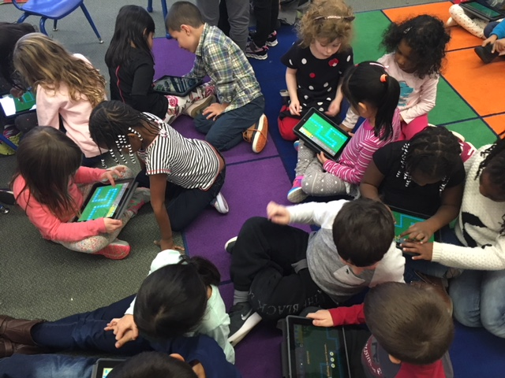
Kindergarten kodable

Slide 8
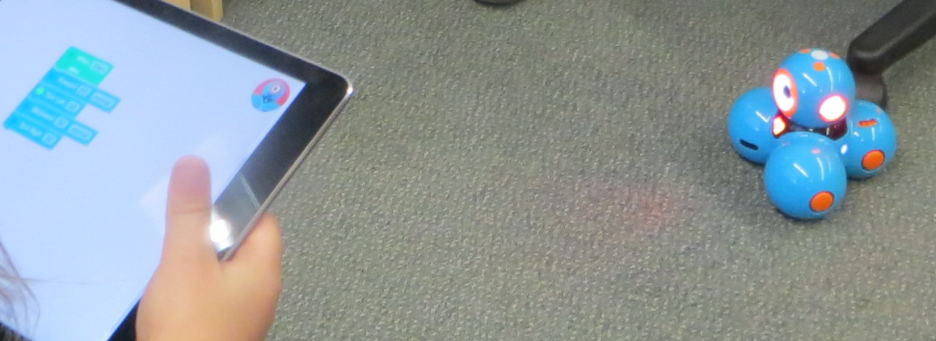
DASH
Grade 1

Slide 9
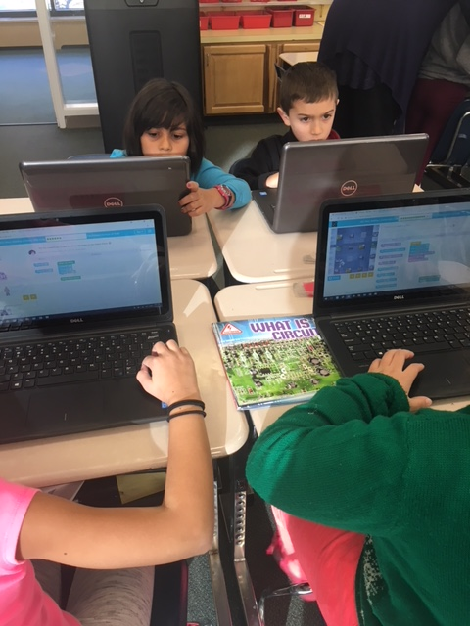
Computational thinker
GRADE 2
CODE.ORG

Slide 10


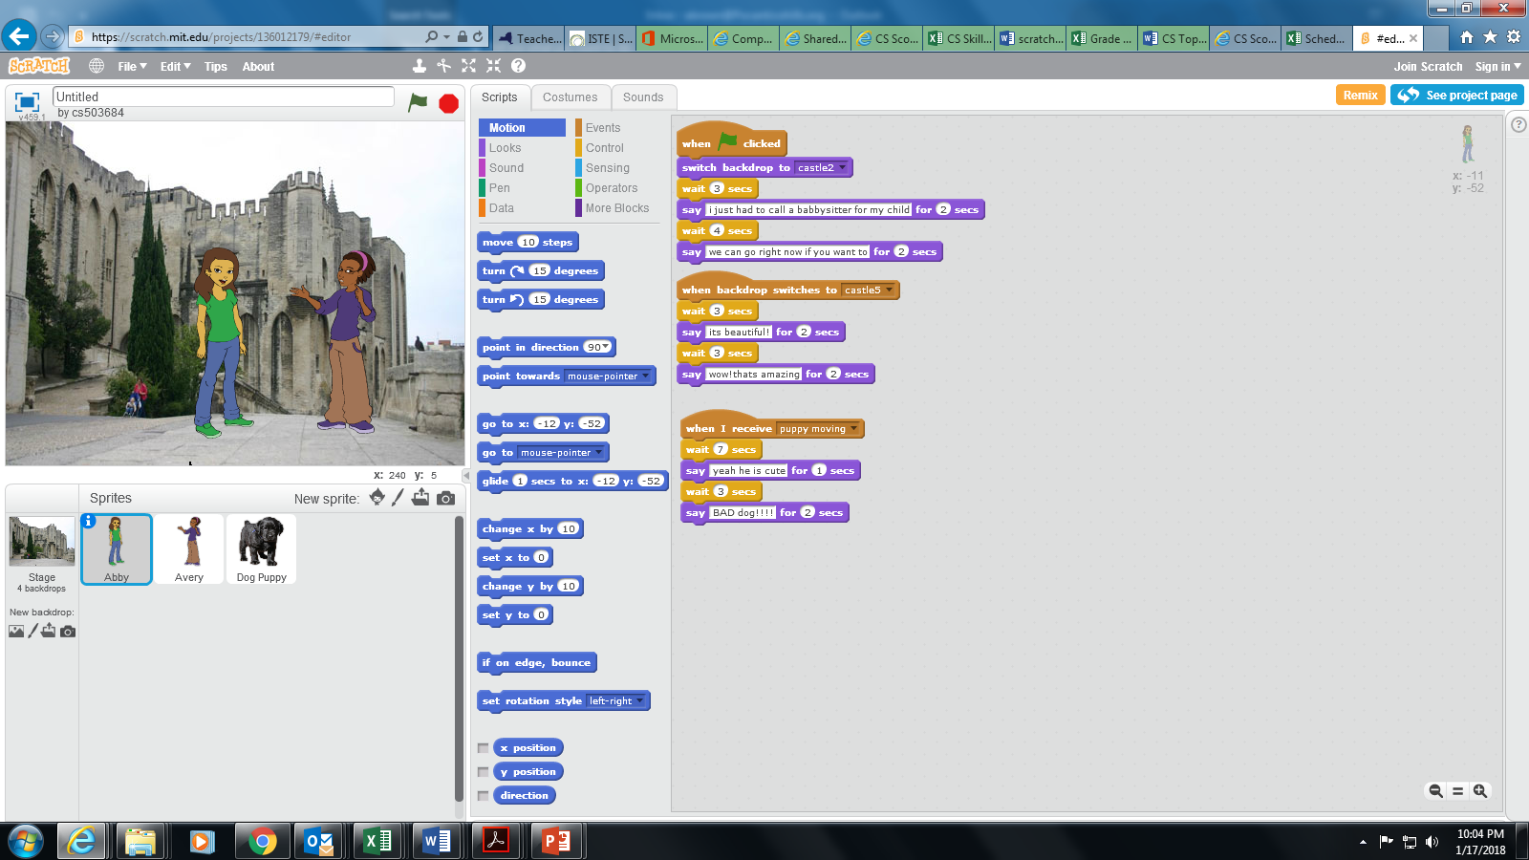
Grade 3
EMPOWERED
LEARNER
&
CREATIVE
COMMUNICATOR
SCRATCH

Slide 11
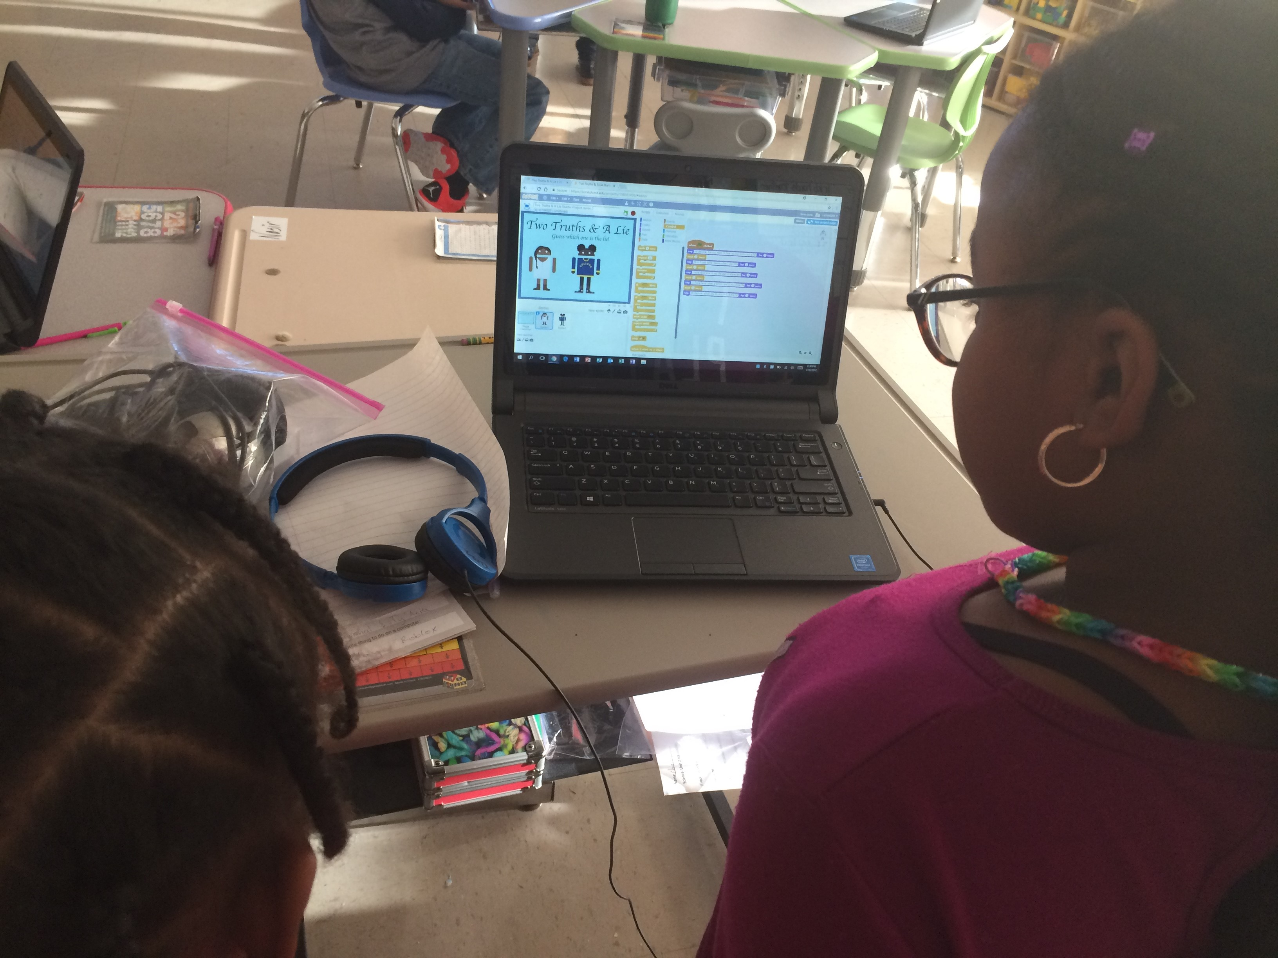
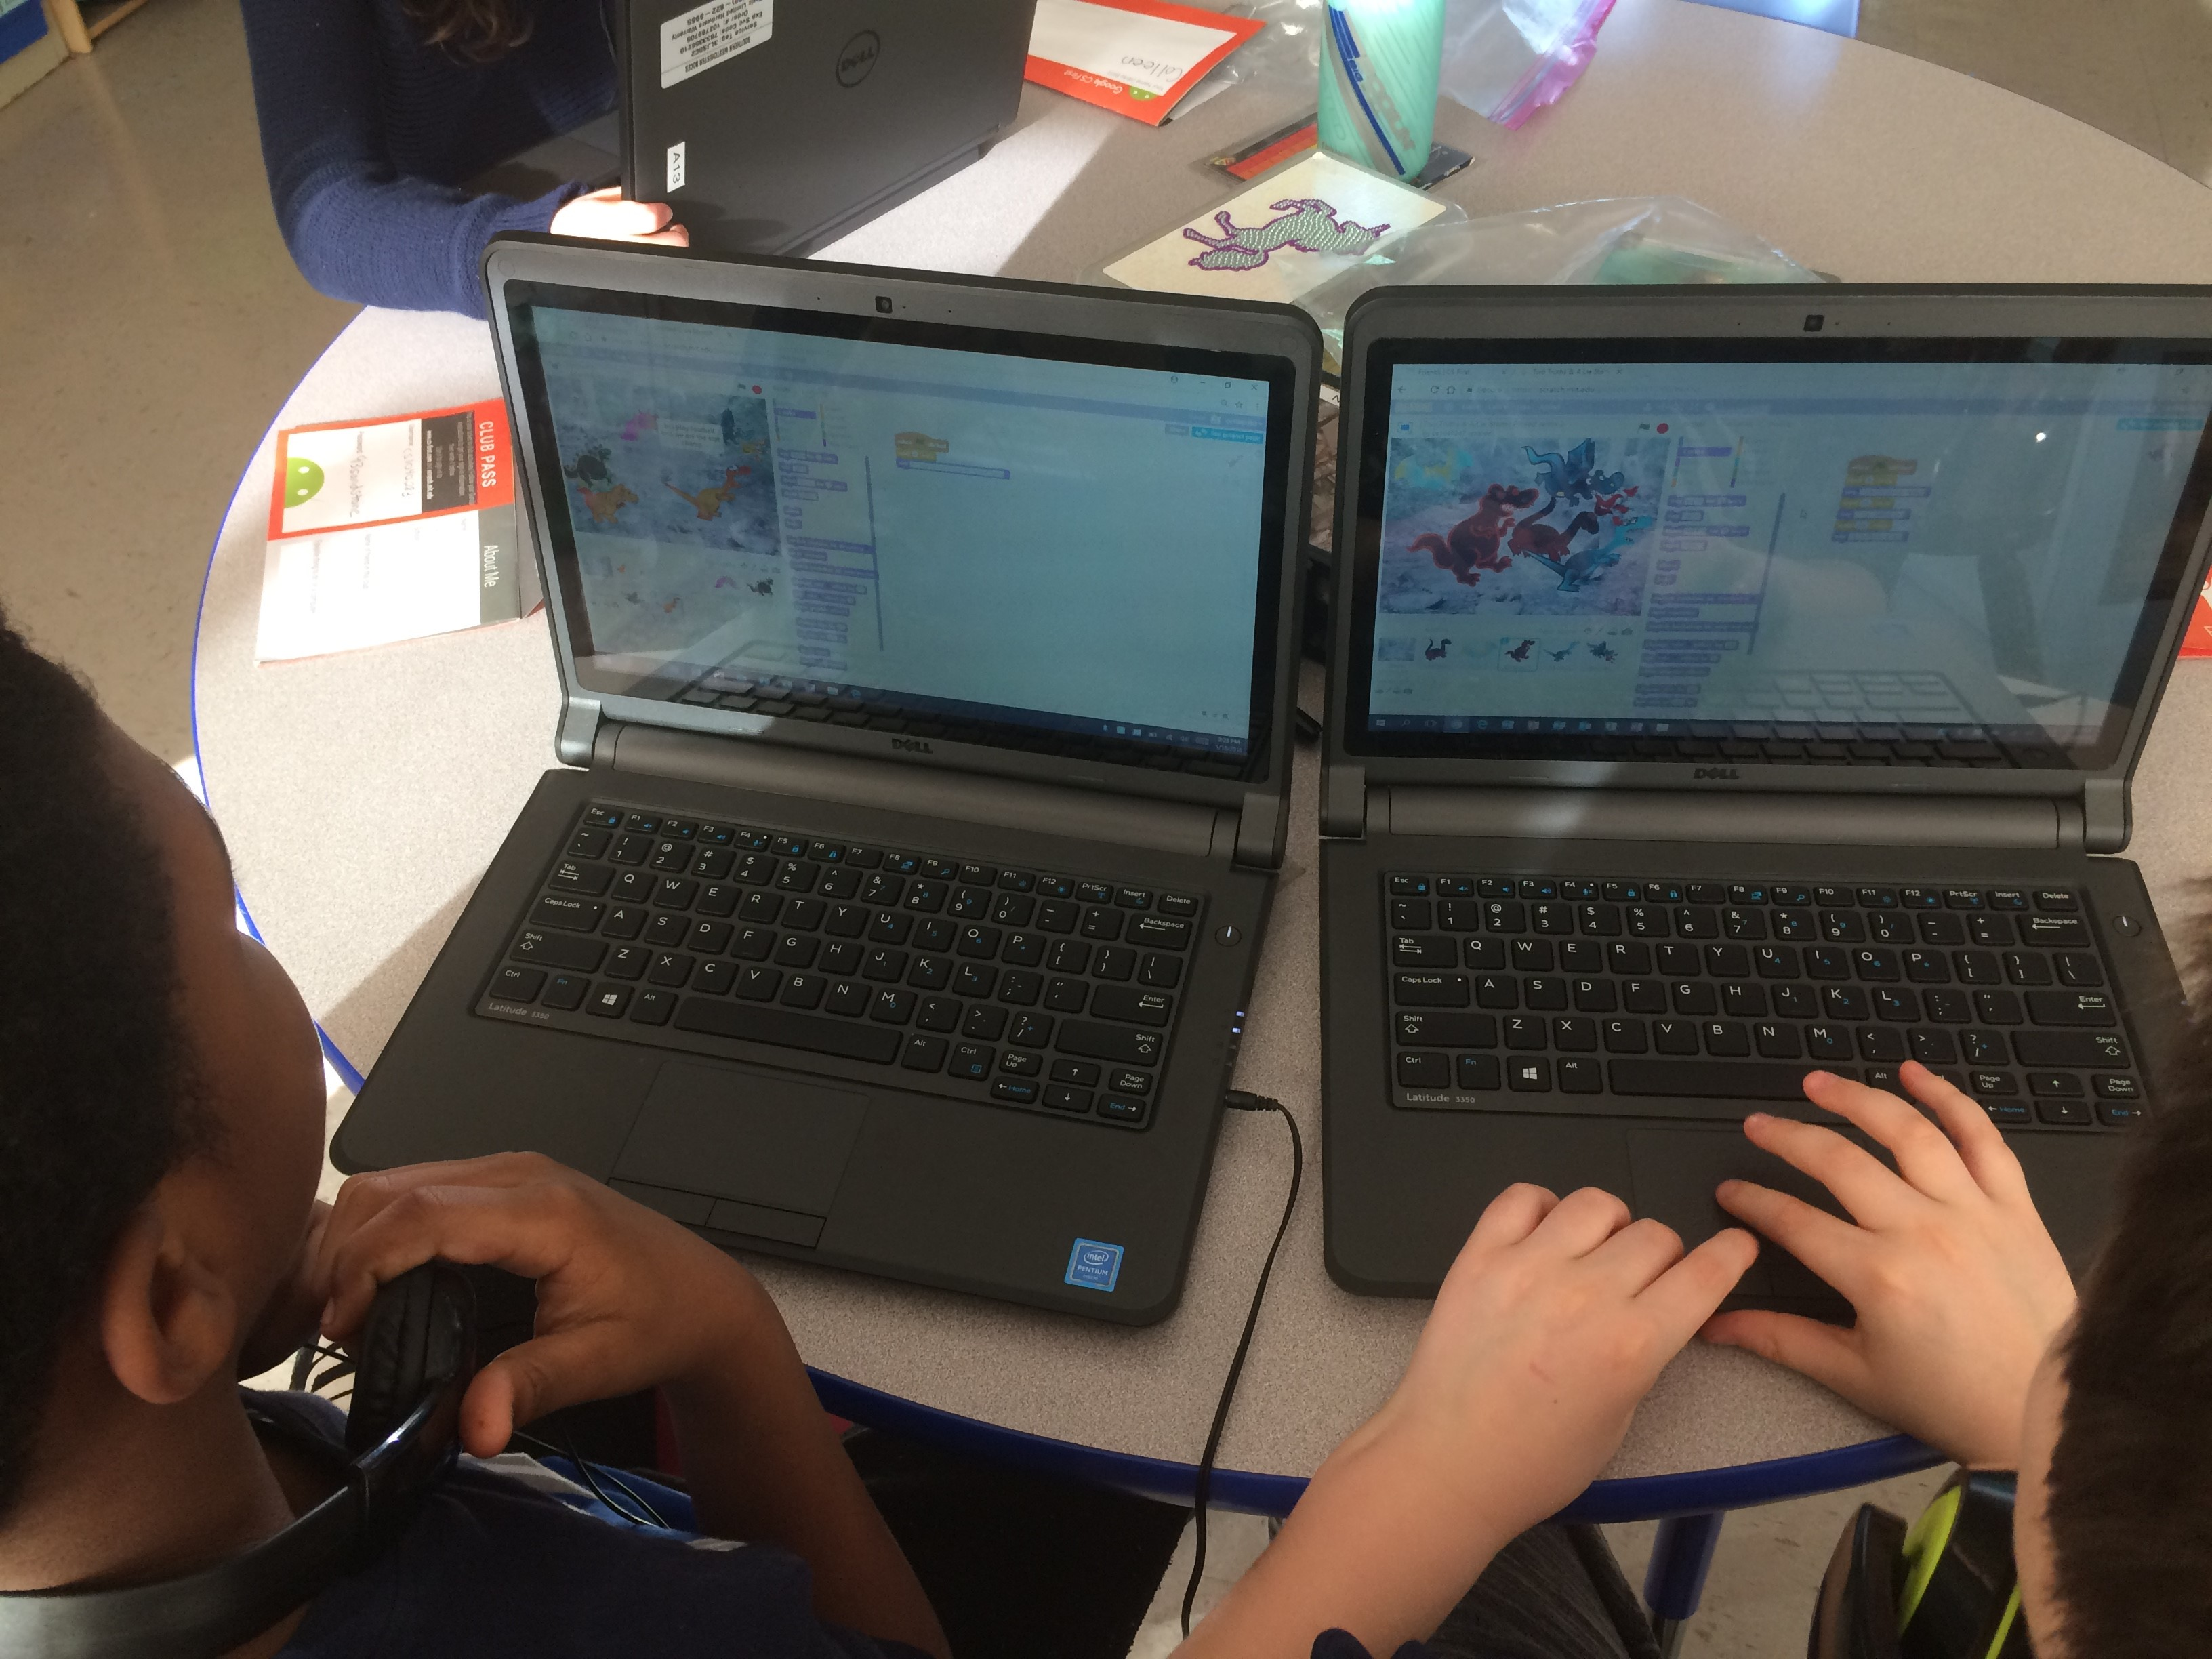
Grade 4
Collaborator and COMMUNICATOR
scratch

Slide 12
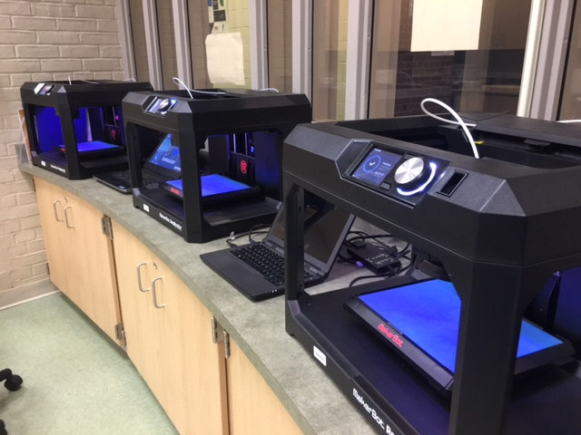
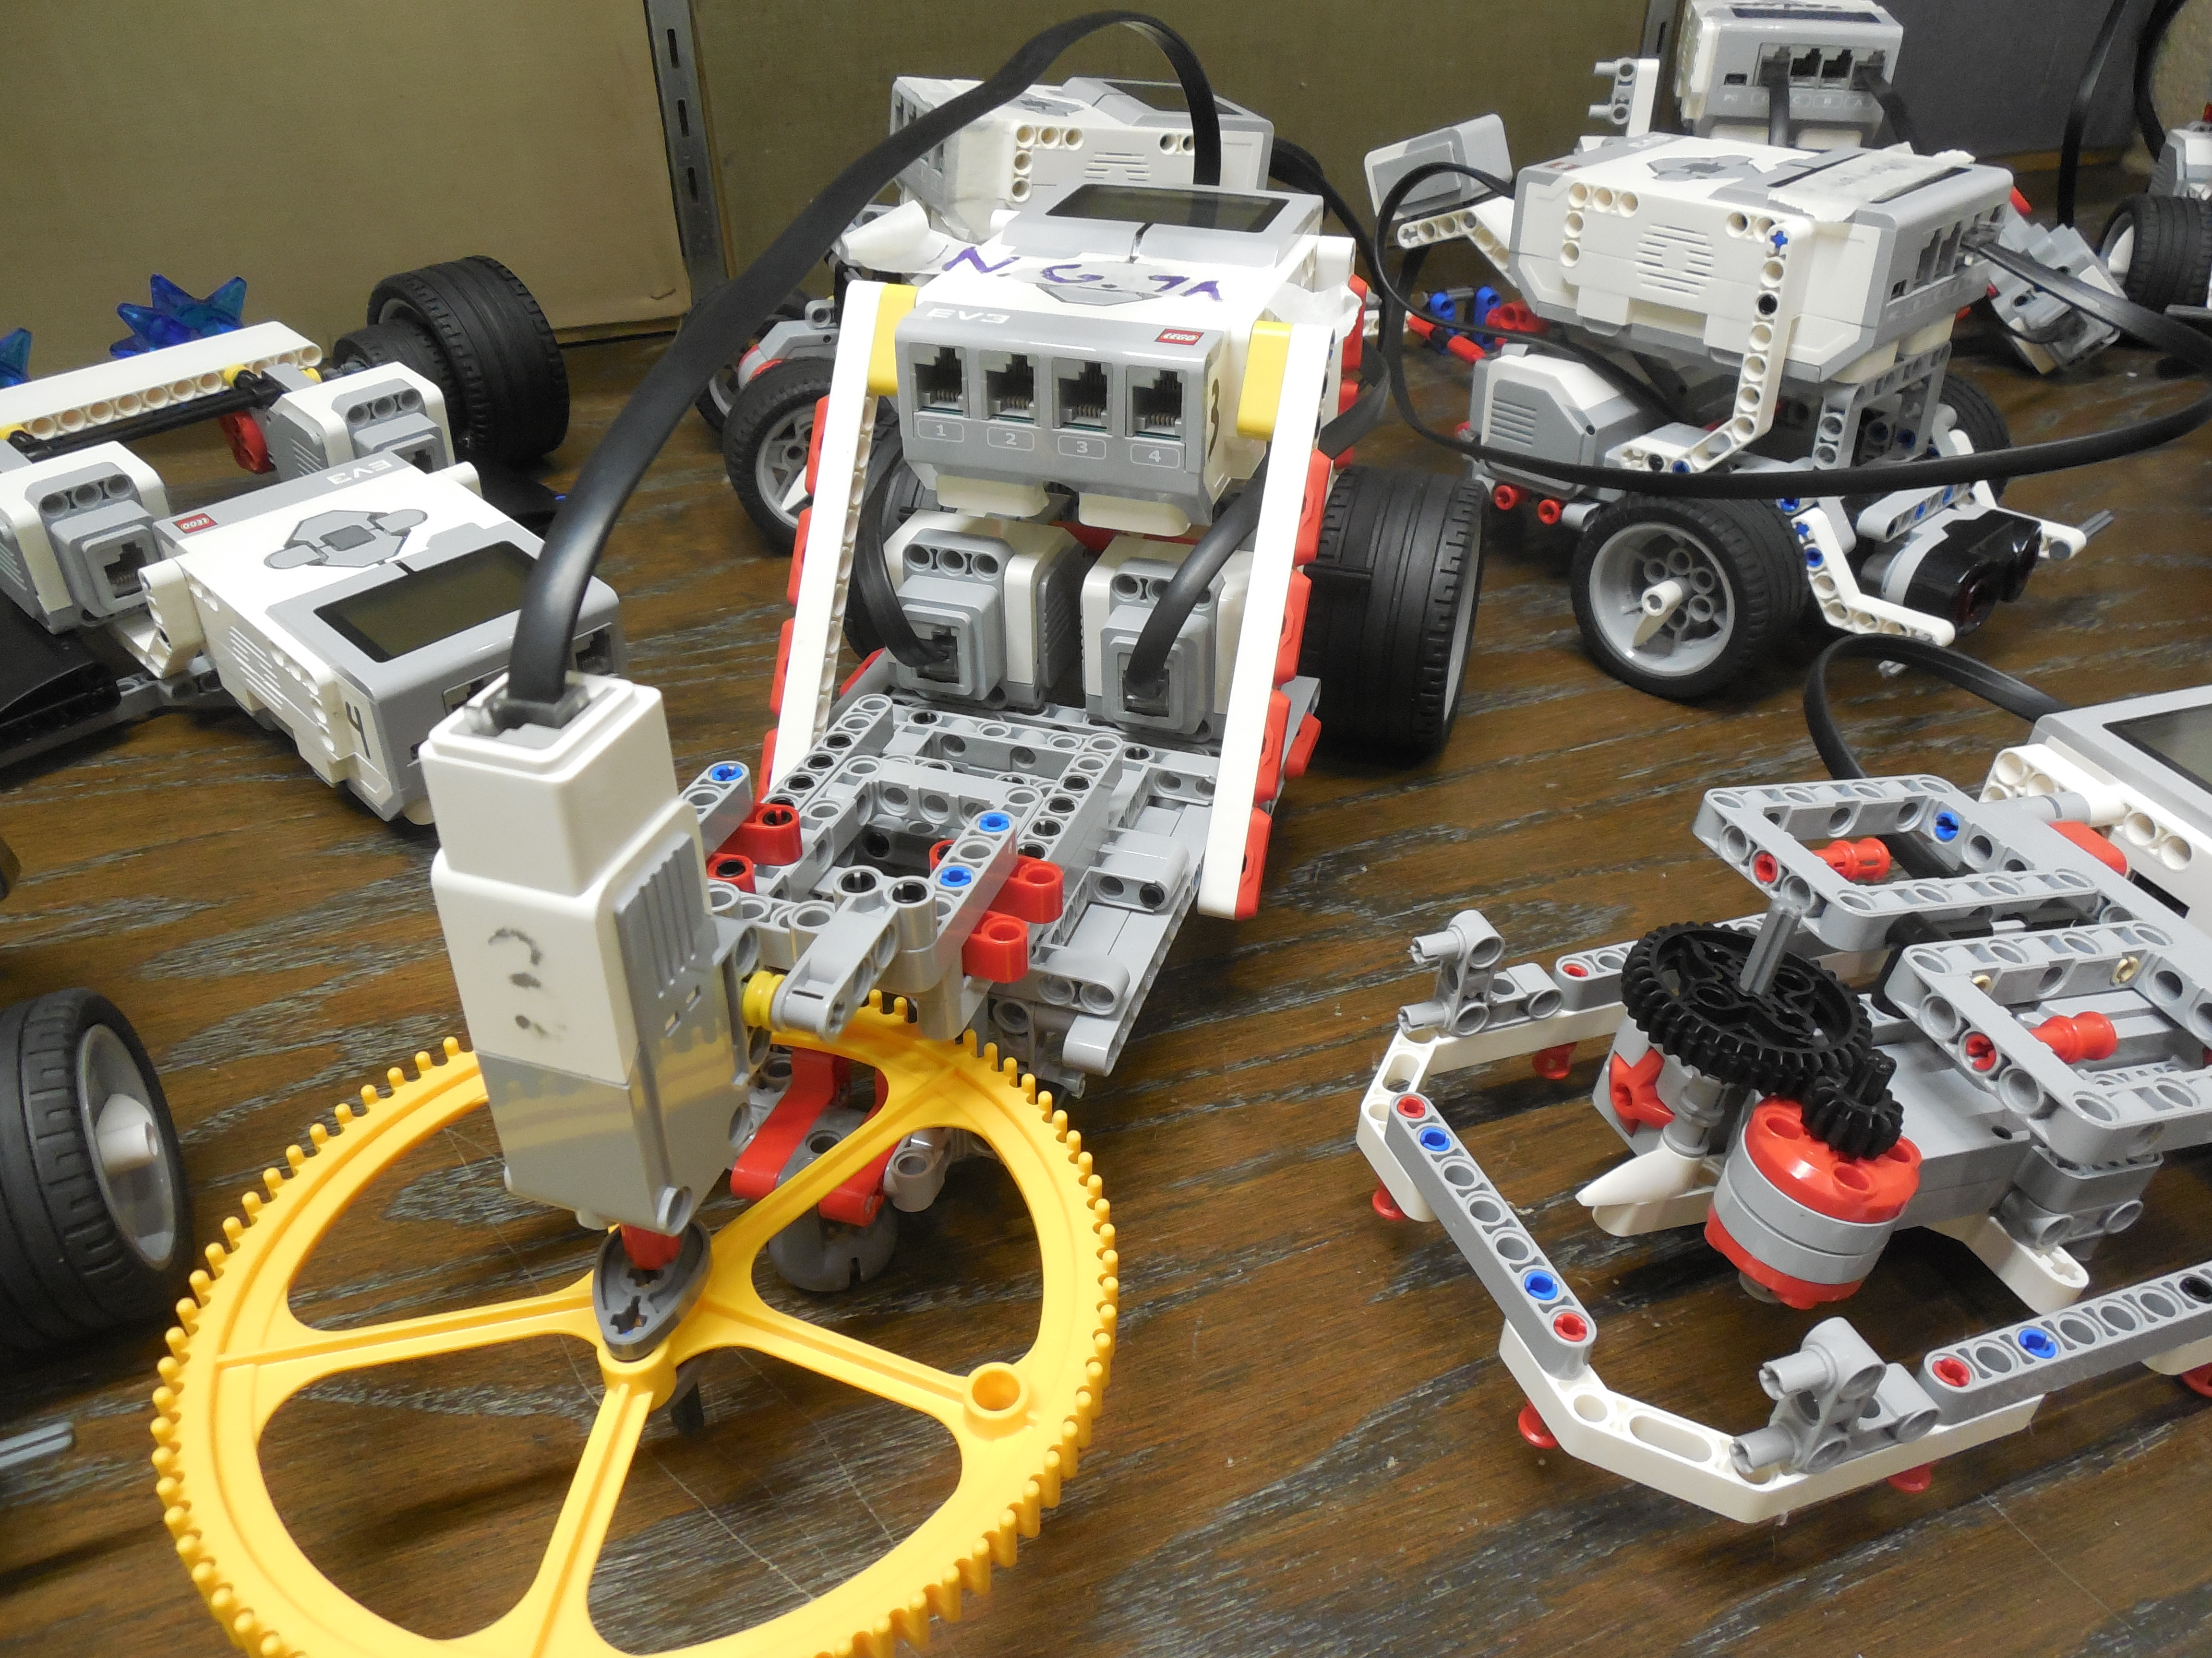
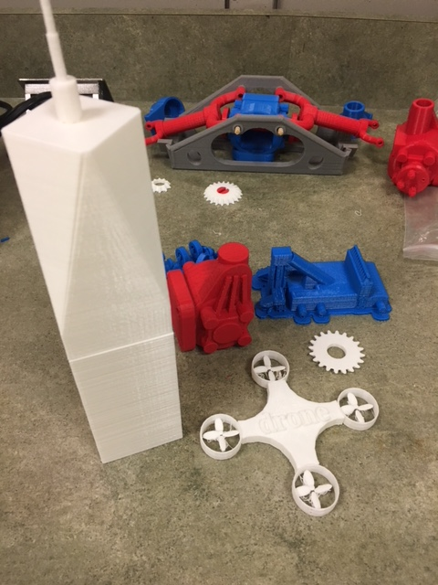
Extracurricular offerings
Robotics
3d printing
Pocademy
PTA NIGHT

Slide 13
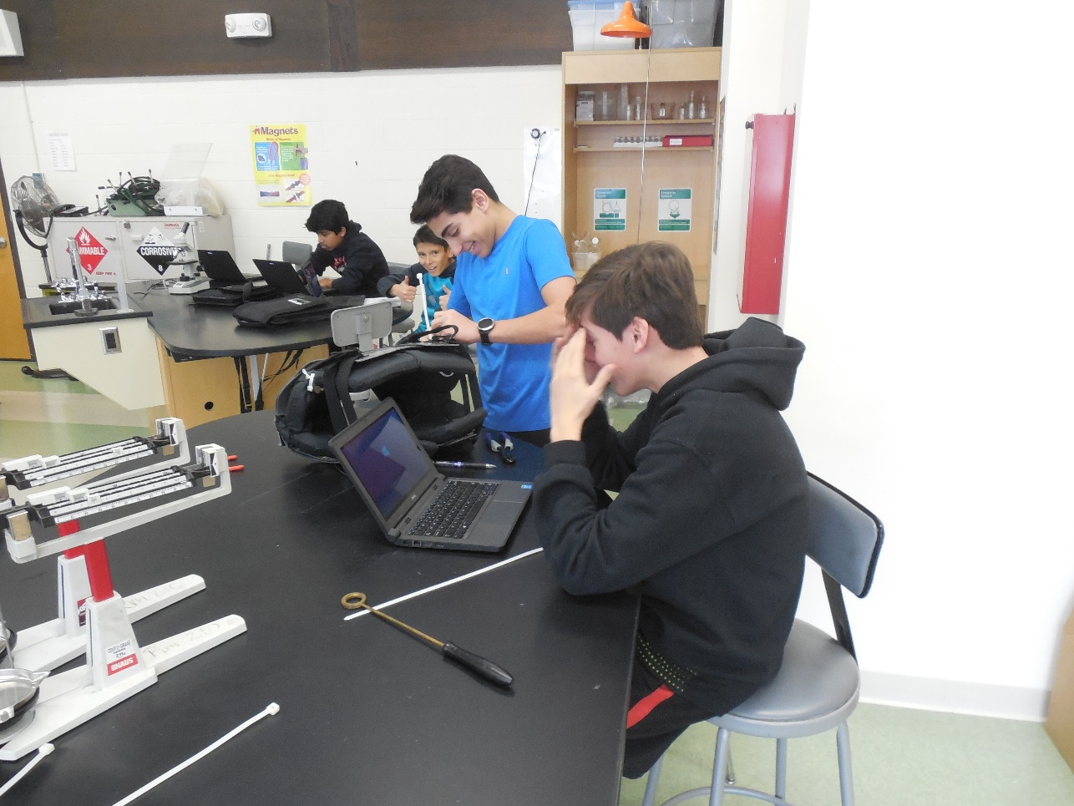
Authenticity of learning
The pursuit of passion projects and the exploration of real-world problems
Pocantico Middle School’s
Genius Hour and Innovation & Design

Slide 14

Authentic
learning
Redefining Teaching and Learning at Pocantico
Teaching that Engages
Culture that Empowers
Technology that Enables
Outcomes that Matter

Slide 15
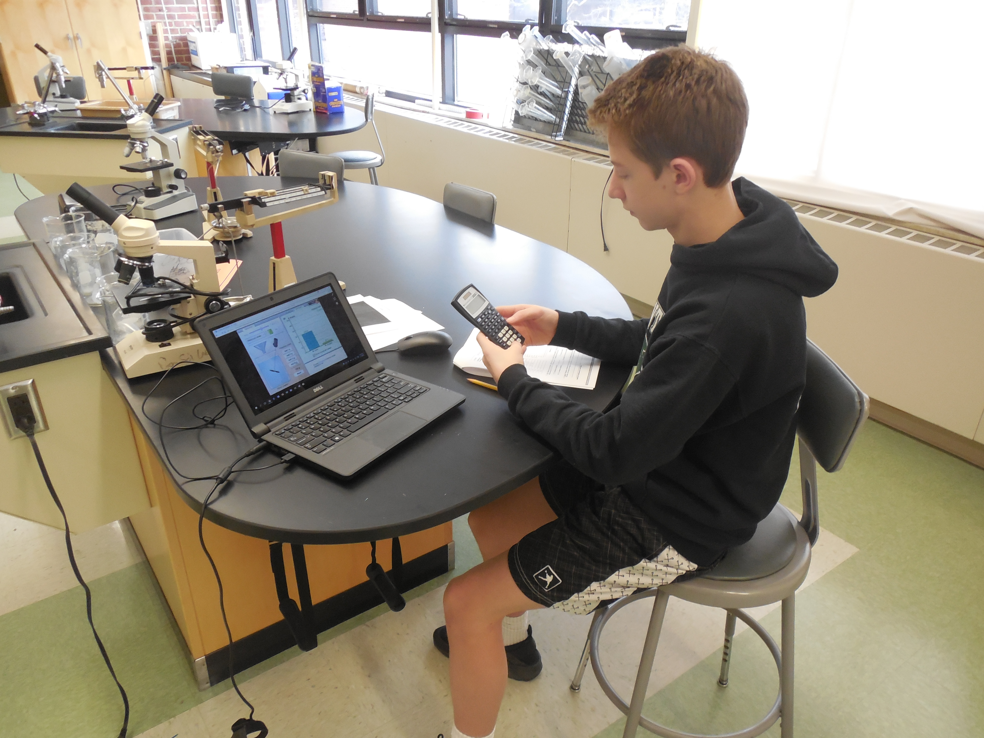
teaching that Engages
Voice & Choice
Student Agency
ISTE Student Standard 1 (Empowered Learner): Students leverage technology to take an active role in choosing, achieving and demonstrating competency in their learning goals, informed by the learning sciences.
ISTE Student Standard 3 (Knowledge Constructor): Students critically curate a variety of resources using digital tools to construct knowledge, produce creative artifacts and make meaningful learning experiences for themselves and others.
ISTE Student Standard 4 (Innovative Designer): Students use a variety of technologies within a design process to identify and solve problems by creating new, useful or imaginative solutions.

Slide 16

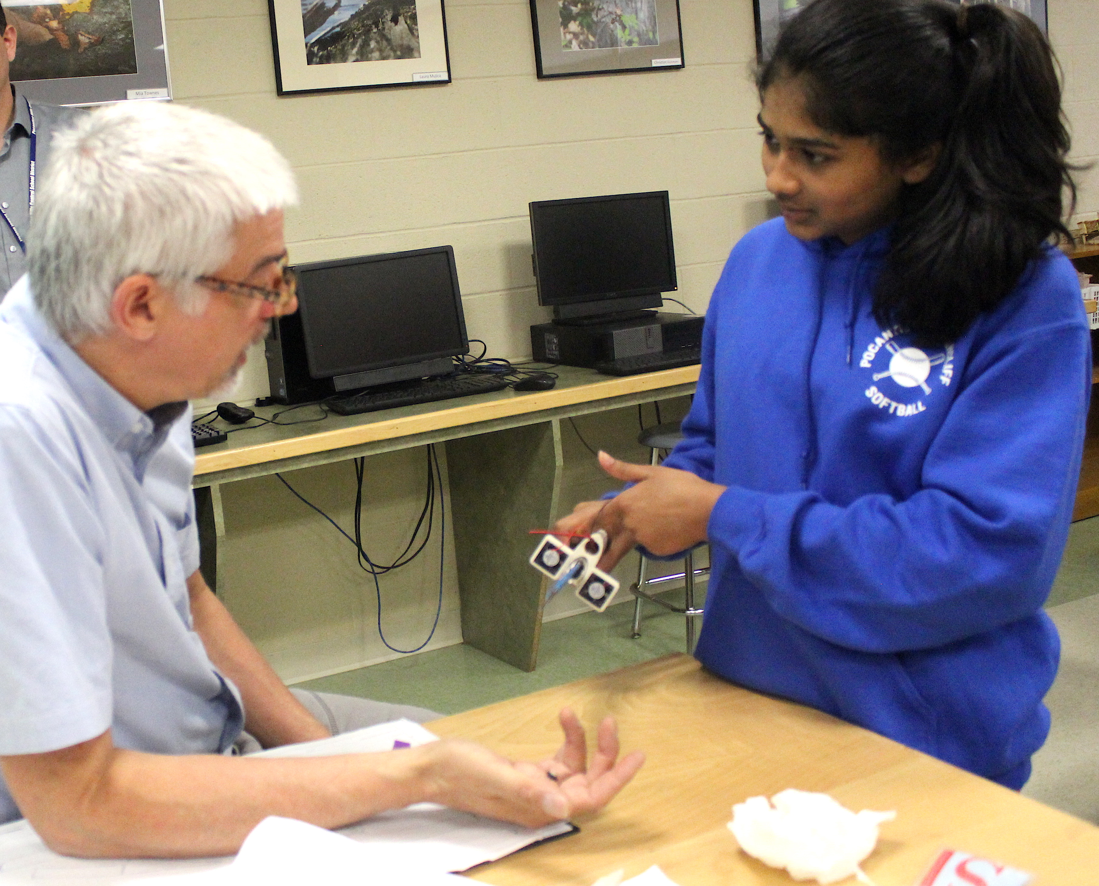
Culture that Empowers
Collaboration
Creativity & Exploration
Growth Mindset
Emotional Intelligence
ISTE Student Standard 2 (Digital Citizen): Students recognize the rights, responsibilities and opportunities of living, learning and working in an interconnected digital world, and they act and model in ways that are safe, legal and ethical.
ISTE Student Standard 7 (Global Communicator): Students use digital tools to broaden their perspectives and enrich their learning by collaborating with others and working effectively in teams locally and globally

Slide 17
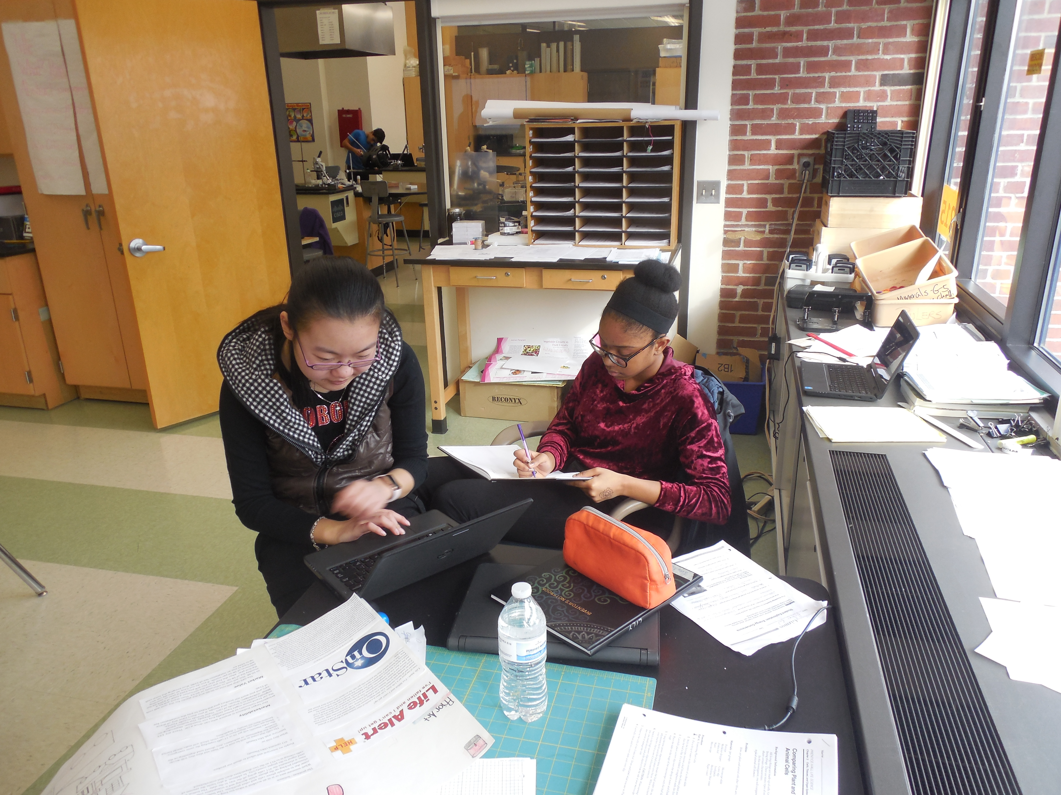
Technology that Enables
Ubiquitous use of Technology
  Digital citizenship
  Product-oriented/STEM supported
ISTE Student Standard 1 (Empowered Learner): Students leverage technology to take an active role in choosing, achieving and demonstrating competency in their learning goals, informed by the learning sciences.
ISTE Student Standard 2 (Digital Citizen): Students recognize the rights, responsibilities and opportunities of living, learning and working in an interconnected digital world, and they act and model in ways that are safe, legal and ethical.
ISTE Student Standard 4 (Innovative Designer): Students use a variety of technologies within a design process to identify and solve problems by creating new, useful or imaginative solutions.
ISTE Student Standard 6 (Creative Communicator): Students communicate clearly and express themselves creatively for a variety of purposes using platforms, tools, styles, formats and digital media appropriate to their goals.

Slide 18
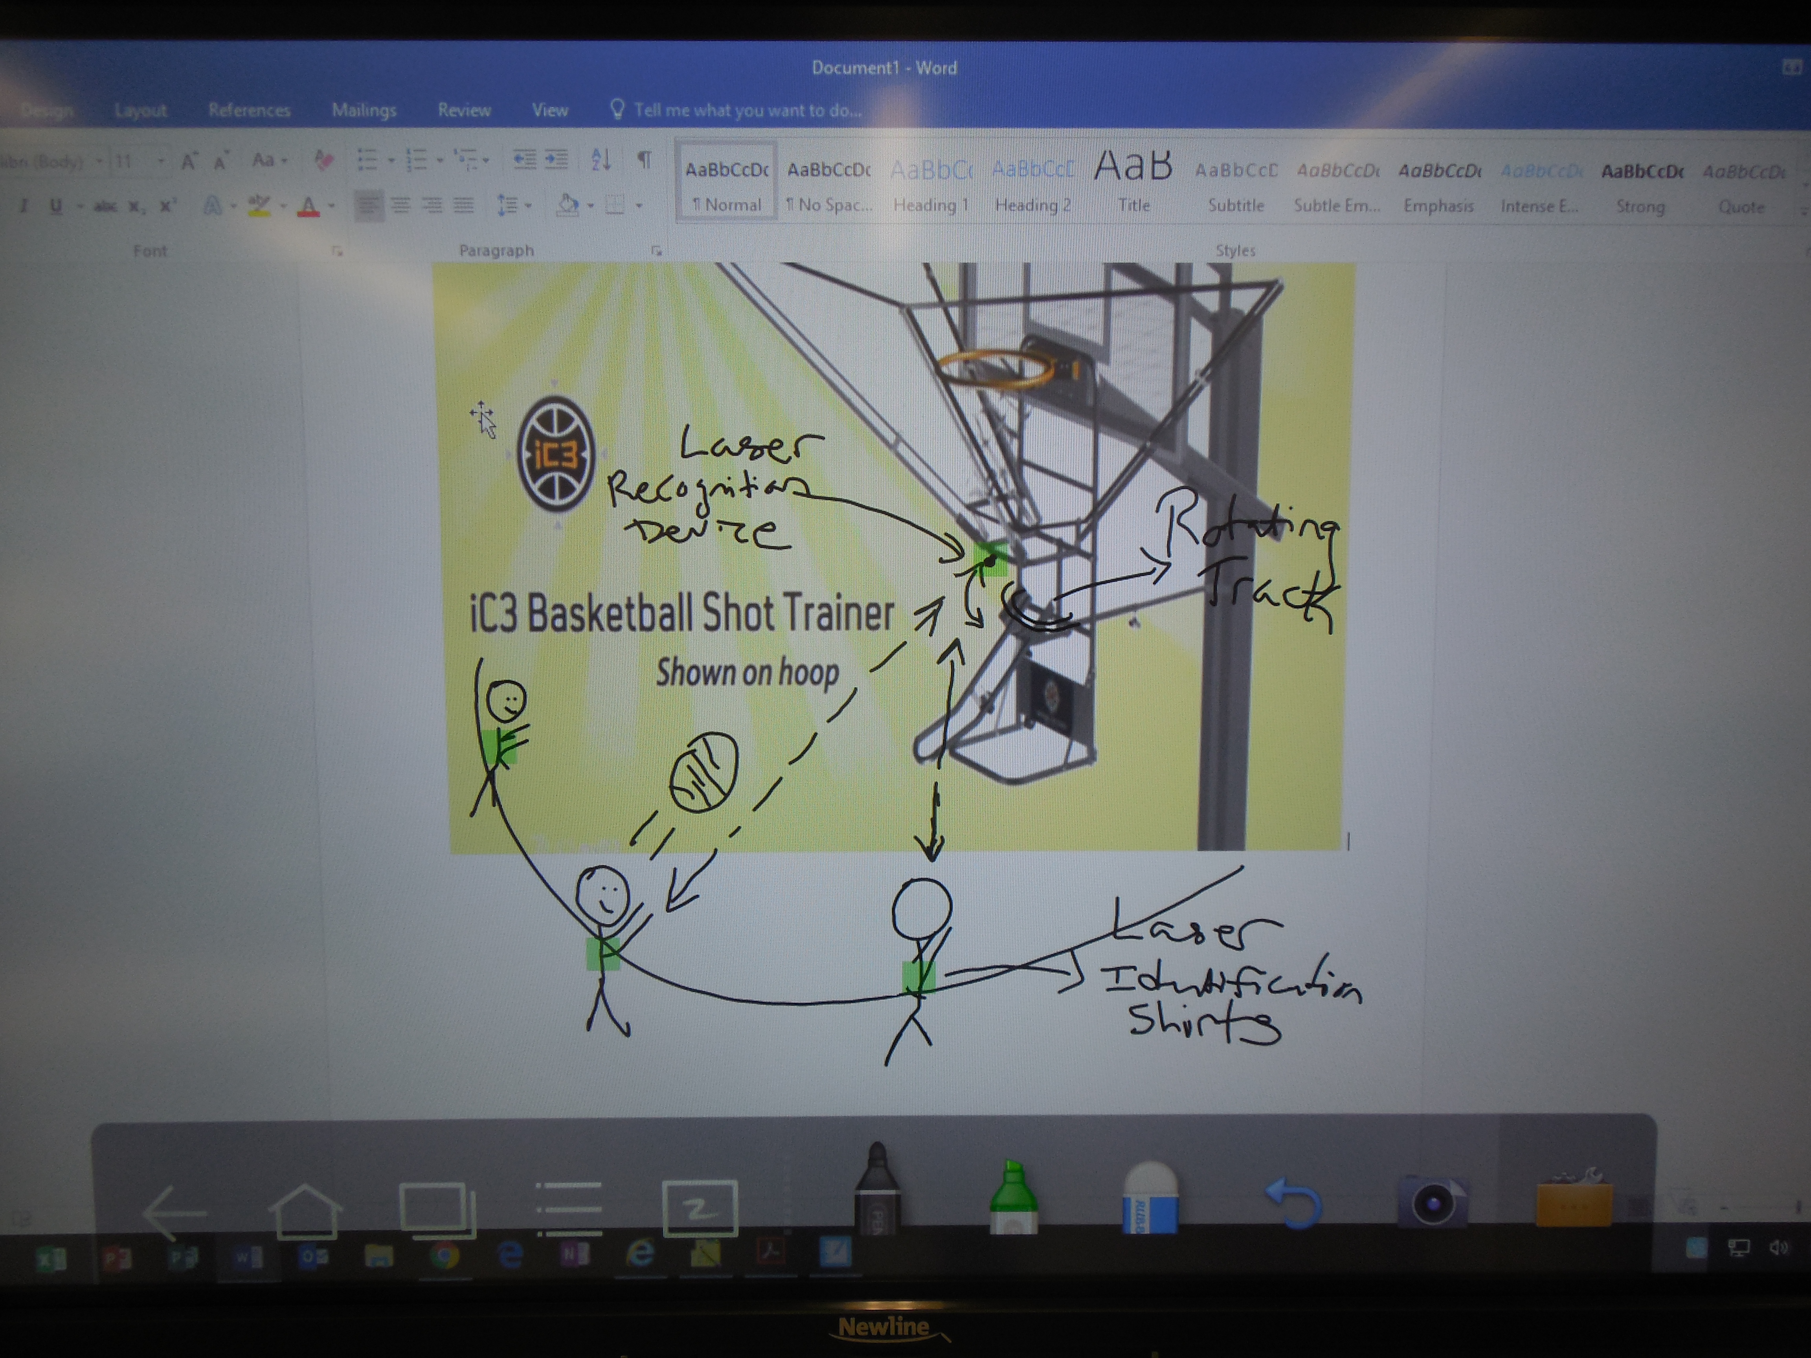
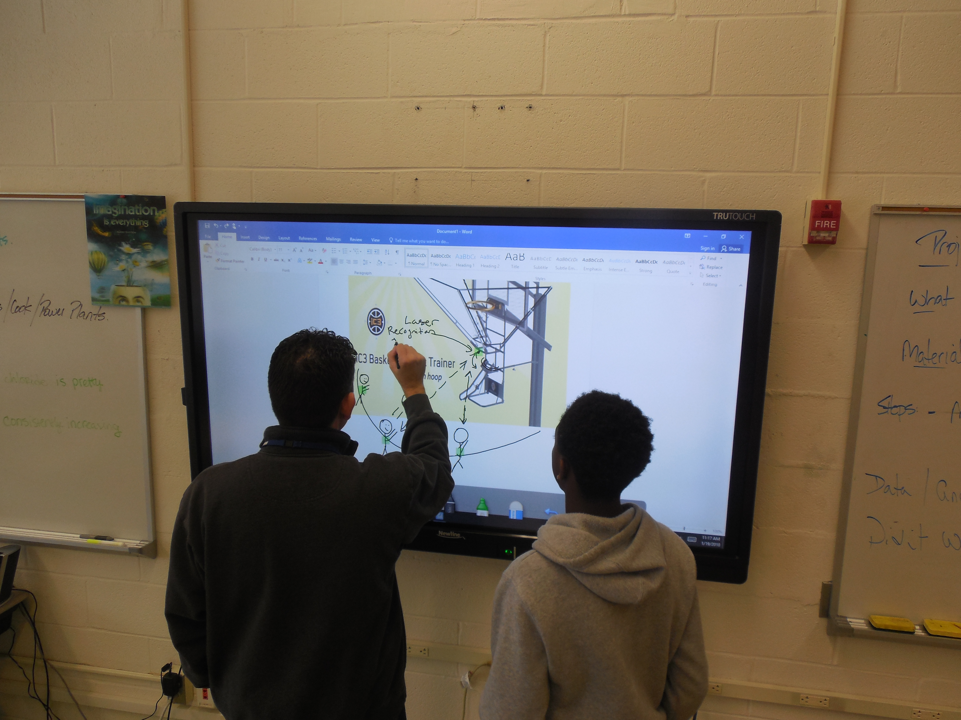
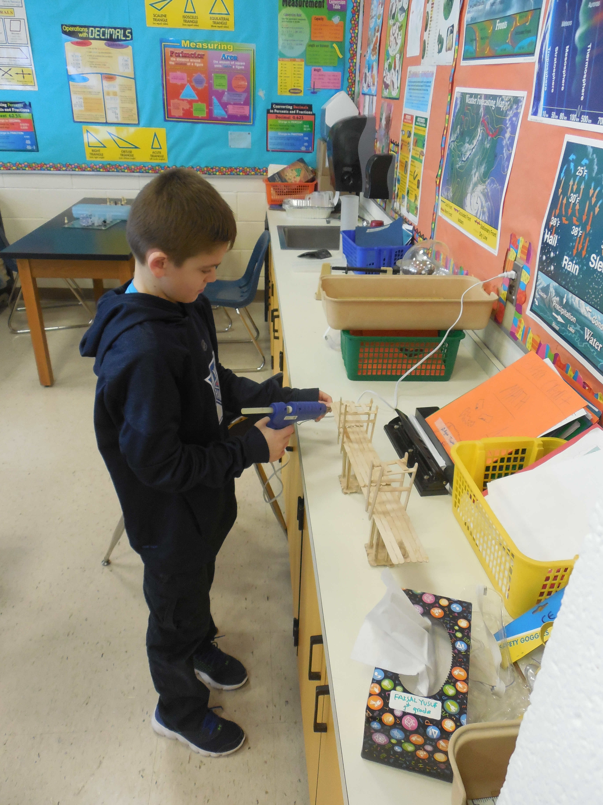
Outcomes that Matter
Oral & Written Communication
Critical Thinking
ISTE Student Standard 3 (Knowledge Constructor): Students critically curate a variety of resources using digital tools to construct knowledge, produce creative artifacts and make meaningful learning experiences for themselves and others.
ISTE Student Standard 5 (Computational Thinker): Students develop and employ strategies for understanding and solving problems in ways that leverage the power of technological methods to develop and test solutions.
ISTE Student Standard 6 (Creative Communicator): Students communicate clearly and express themselves creatively for a variety of purposes using platforms, tools, styles, formats and digital media appropriate to their goals.

